Slide 1

Compression Algorithms
CE2103 - Algorithms and Data Structures II

Slide 2
Disclaimer / Descargo de Responsabilidad
Esta presentación corresponde a una guía usada por el profesor durante las clases. La misma ha sido modificada para ser utilizado en el modelo de cursos asistidos por tecnología. No es una versión final, por lo que la misma podría requerir todavía hacer algunos ajustes. Para aspectos de evaluación esta presentación es solo una guía, por lo que el estudiante debe profundizar con el material de lectura asignado y lo discutido en clases para aspectos de evaluación.
This presentation corresponds to a guide material used by the professor during classes. It has been modified to be used in the model of technology-assisted courses. It is not a final version, so it may still require some adjustments. For evaluation aspects, this presentation is only a guide, so the student should delve with the assigned reading material and what has been discussed in class.

Slide 3
Introduction
Bit-rate reduction involves encoding information using fewer bits than the original representation.
Types of compression:
Lossless compression. Reduces bits by identifying and eliminating statistical redundancy, no information is lost.
Lossy compression. Reduces bits by identifying unnecessary information and removing it.
Arithmetic Coding. Used in lossless and lossy algorithms. The frequently seen symbols are encoded with fewer bits than rarely seen symbols. Encodes the entire message into a single number.

Slide 4
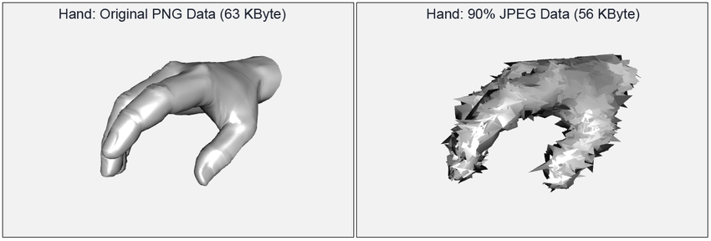
Lossy Algorithms

Slide 5
Lossy Compression
Lossy compression is compression in which some of the information from the original message sequence is lost.
This means the original sequences cannot be regenerated from the compressed sequence.

Slide 6
Lossy Compression
Lossy compression is the class of data encoding methods that uses inexact approximations to represent the content.
Well-designed lossy compression technology often reduces file sizes significantly before degradation is noticed by the end-user.

Slide 7

Lossy Compression
Lossy compression is most commonly used to compress multimedia data (audio, video, and images), especially in applications such as streaming media.

Slide 8


Lossy Compression (Examples)

Slide 9

Lossy Compression (Example)

Slide 10
Lossless Compression

Slide 11
Introduction
Reduces bits by identifying and eliminating statistical redundancy.
No information is lost. This algorithms allows the original data to be perfectly reconstructed from the compressed data.
Examples of Lossless Compression Algorithms:
Huffman Code.
LZ77.
LZ78.
LZW.

Slide 12
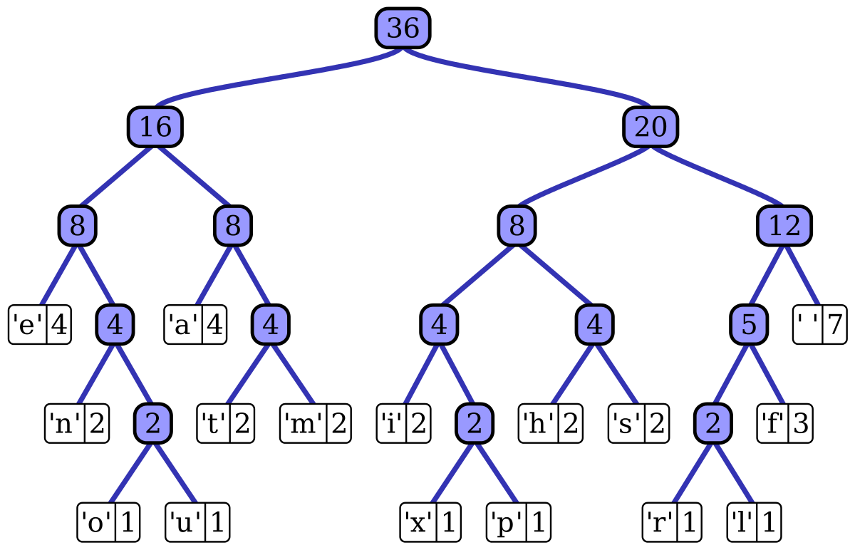
Huffman Code

Slide 13
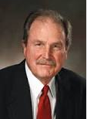
Huffman Code
David Huffman developed the algorithm as a student in a class on information theory at MIT in 1950.
The idea behind Huffman coding is assign binary codes the most short as possible to those symbols that occur most frequently in the data.
Symbols infrequently binary codes will be
assigned greater length.
The Huffman algorithm build a binary tree,
this tree is used to assign codes to the input
symbols.

Slide 14
Huffman Code
Applications: JPEG, PNG
David Huffman developed the algorithm as a student in a class on information theory at MIT in 1950.
The idea behind Huffman coding is assign binary codes the most short as possible to those symbols that occur most frequently in the data.
Symbols infrequently binary codes will be
assigned greater length.
The Huffman algorithm build a binary tree,
this tree is used to assign codes to the input
symbols.

Slide 15
Huffman Code (Strategy)
A first pass on the data to compress is performed to obtain the statistics of symbols.
Symbols are arranged in a list according to its probability. This ordered list symbols are the initial node to the tree construction. If the list contains only one node, finish.
Select the two nodes (L and R) from the list with the smallest probabilities.
A new node (F) is created and built a subtree being F the father of L and R the left and right respectively children. The arc between the F and L nodes are labeled 0 and the arc between nodes F and R is labeled as one.
F is added to the sorted list, with the probability value equal to the sum of to L and R.

Slide 16
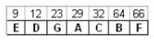
Huffman Code (Example)
1

Slide 17
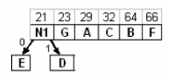
Huffman Code (Example)
1
2

Slide 18
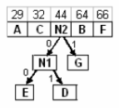
Huffman Code (Example)
1
2
3

Slide 19
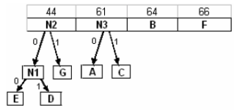
Huffman Code (Example)
1
4
2
3

Slide 20
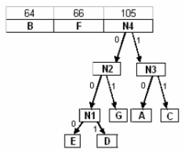
Huffman Code (Example)
1
4
2
5
3

Slide 21
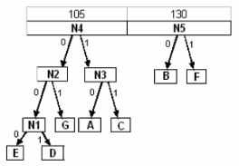
Huffman Code (Example)
4
6
5

Slide 22
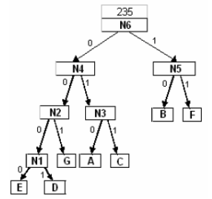
Huffman Code (Example)
6
7

Slide 23
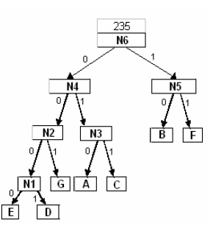
Huffman Code (Example)
RESULT
OUTPUT

Slide 24
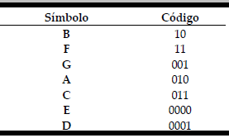
Huffman Code (Example)
RESULT
OUTPUT

Slide 25
Huffman Code (Example)
RESULT
OUTPUT

Slide 26
Huffman Code (Example)
RESULT
OUTPUT

Slide 27
Huffman Code (Example)
RESULT
OUTPUT

Slide 28
Huffman Code (Example)
RESULT
OUTPUT
These codes are stored with the compressed data, so the decompressor can reconstruct the original data.
The compressor constructs the Huffman tree and starts decompression positioned at the root of the tree.

Slide 29
Huffman Code (Decompression)
The decompressor reads the first bit of the compressed data, if zero, moves to the right child, if it is one, it moves to the left child.
The process is repeated, the next bit of the compressed data is read and is moving towards the right child if the read bit is a zero or left if the bit read is a one.
When the process reaches a leaf on the tree, the decompressor find the original code and returns the value of the symbol as uncompressed data.
The decompressor is again placed in the root of the tree and the same process is repeated.

Slide 30
Huffman Code (Decompression)
RESULT
OUTPUT
Decompress the following sequence: 011010110000

Slide 31
Huffman Code (Decompression)
RESULT
OUTPUT
Decompress the following sequence: 011010110000

Slide 32
Huffman Code (Decompression)
RESULT
OUTPUT
Decompress the following sequence: 011010110000

Slide 33
Huffman Code (Decompression)
RESULT
OUTPUT
Decompress the following sequence: 011010110000

Slide 34
Huffman Code (Decompression)
RESULT
OUTPUT
Decompress the following sequence: 011010110000
C

Slide 35
Huffman Code (Decompression)
RESULT
OUTPUT
Decompress the following sequence: 011010110000
C

Slide 36
Huffman Code (Decompression)
RESULT
OUTPUT
Decompress the following sequence: 011010110000
C

Slide 37
Huffman Code (Decompression)
RESULT
OUTPUT
Decompress the following sequence: 011010110000
C

Slide 38
Huffman Code (Decompression)
RESULT
OUTPUT
Decompress the following sequence: 011010110000
C A

Slide 39
Huffman Code (Decompression)
RESULT
OUTPUT
Decompress the following sequence: 011010110000
C A F E

Slide 40
Huffman Code (Example)
Compress the following text:
“abfabcaecedba”

Slide 41
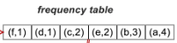
Huffman Code (Example)
Compress the following text:
“abfabcaecedba”
RESULT
OUTPUT

Slide 42
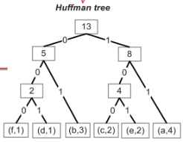
Huffman Code (Example)
Compress the following text:
“abfabcaecedba”
RESULT
OUTPUT

Slide 43
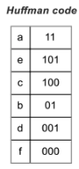
Huffman Code (Example)
Compress the following text:
“abfabcaecedba”
RESULT
OUTPUT
11010001101100111011001010010111

Slide 44
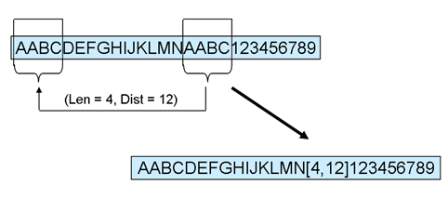
LZ77

Slide 45
LZ77
Developed by Abraham Lempel and Jacob Ziv in 1977. Also called LZ1.
The principle of this method is to use part of the entrance sequence as a dictionary.
The encoder keeps an intermediate string (or buffer) memory called "window" and moves the data entered in it, from right to left, as to be encoding symbols.
The method is based on a sliding window.

Slide 46
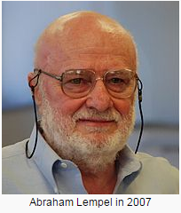
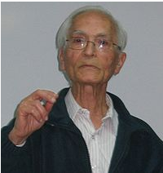
LZ77
Developed by Abraham Lempel and Jacob Ziv in 1977. Also called LZ1.
The principle of this method is to use part of the entrance sequence as a dictionary.
The encoder keeps an intermediate string (or buffer) memory called "window" and moves the data entered in it, from right to left, as to be encoding
symbols.
The method is based on a
sliding window.

Slide 47
LZ77
Applications: GZIP
Developed by Abraham Lempel and Jacob Ziv in 1977. Also called LZ1.
The principle of this method is to use part of the entrance sequence as a dictionary.
The encoder keeps an intermediate string (or buffer) memory called "window" and moves the data entered in it, from right to left, as to be encoding
symbols.
The method is based on a
sliding window.

Slide 48
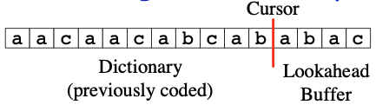
LZ77 (Strategy)
The basic algorithm is very simple and loops executing the following steps:
Find the longest match of a string starting at the cursor and completely contained in the lookahead buffer to a string starting in the dictionary.
Output a triple (p, n, c) where:
p = position of the longest match that starts in the dictionary (relative to the cursor).
n = length of the longest match.
c = next char in buffer beyond longest match.

Slide 49
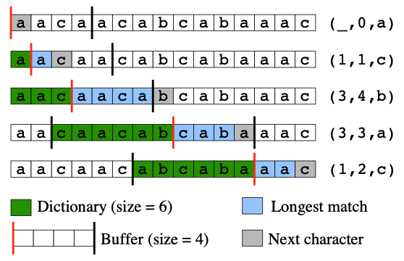
LZ77 (Example)
Compress the following text: “aacaacabcabaaac”

Slide 50
LZ77 (Example)
Compress the following text: “aacaacabcabaaac”

Slide 51
LZ77 (Example)
Compress the following text: “aacaacabcabaaac”

Slide 52
LZ77 (Example)
Compress the following text: “aacaacabcabaaac”

Slide 53
LZ77 (Example)
Compress the following text: “aacaacabcabaaac”

Slide 54
LZ77 (Decompression)
The decoder read each triplet (p, n, c). Two cases can occur:
p is equal to zero
c is written to the output file.
p is different to zero
The substring in the buffer starting position p (count from right to left) and length N is copied to the output file.
c is written to the output file.

Slide 55
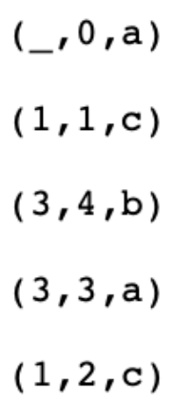
LZ77 (Decompression)
Remember, this was the initial instruction
Compress the following text: “aacaacabcabaaac”

Slide 56
LZ77 (Decompression)
Compress the following text: “aacaacabcabaaac”
And this was the output

Slide 57
LZ77 (Decompression)
Compress the following text: “aacaacabcabaaac”
a

Slide 58
LZ77 (Decompression)
Compress the following text: “aacaacabcabaaac”
aac

Slide 59
LZ77 (Decompression)
Compress the following text: “aacaacabcabaaac”
aacaacab

Slide 60
LZ77 (Decompression)
Compress the following text: “aacaacabcabaaac”
aacaacabcaba

Slide 61
LZ77 (Decompression)
Compress the following text: “aacaacabcabaaac”
aacaacabcabaaac

Slide 62
LZ77 (Example)
Compress the following text: “cabracadabrarrarrad”
Diccionary (size = 7)
Buffer (size = 6)

Slide 63
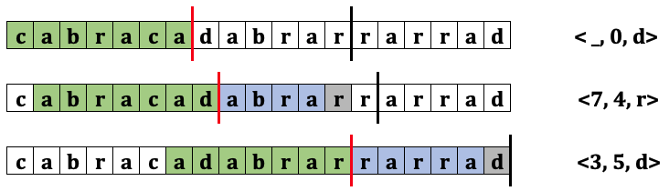
LZ77 (Example)
Compress the following text: “cabracadabrarrarrad”
Diccionary (size = 7)
Buffer (size = 6)
Using full Diccionary.

Slide 64
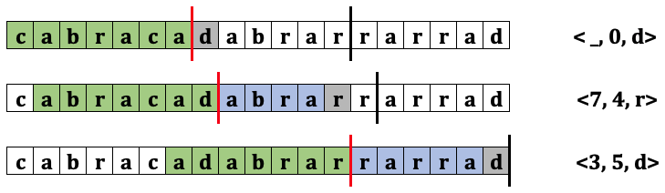
LZ77 (Example)
Compress the following text: “cabracadabrarrarrad”
Diccionary (size = 7)
Buffer (size = 6)
Using full Diccionary.

Slide 65
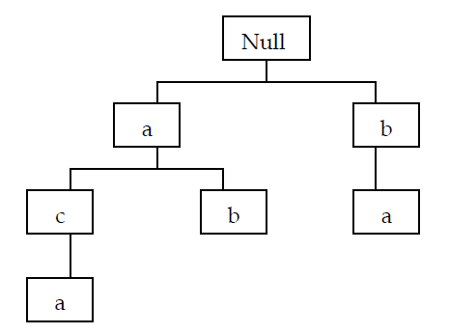
LZ78

Slide 66
LZ78
Developed by Abraham Lempel and Jacob Ziv in 1978. Also called LZ2.
LZ78 does not use a window on the data to be compressed.
There are a dictionary containing the chains that have occurred previously.
The dictionary is initially empty and its size is limited by available memory.

Slide 67
LZ78
The codeword consists only of two fields, a pointer or index field that identifies the position of a string in the dictionary and a field containing the last symbol has been read from the entrance.
The representation of the dictionary can be a tree structure called trie.

Slide 68
LZ78
Applications: GIF
The codeword consists only of two fields, a pointer or index field that identifies the position of a string in the dictionary and a field containing the last symbol has been read from the entrance.
The representation of the dictionary can be a tree structure called trie.

Slide 69
LZ78 (Strategy)
The basic algorithm is very simple and loops executing the following steps:
While there are symbols at the entrance:
S = Null, Pos = 0
X = next input symbol, S = SX
While S exists in the dictionary
Pos = Pos(S)
X = next input symbol, S= SX
Output: (Pos, X)
Save S in the dictionary

Slide 70
LZ78 (Example)
Compress the following text: “abacabacaba”

Slide 71
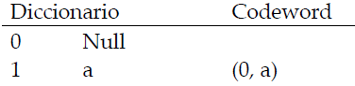
LZ78 (Example)
Compress the following text: “abacabacaba”

Slide 72
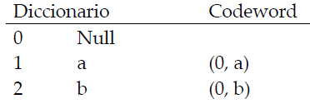
LZ78 (Example)
Compress the following text: “abacabacaba”

Slide 73
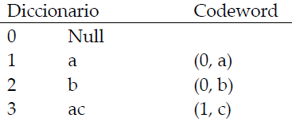
LZ78 (Example)
Compress the following text: “abacabacaba”

Slide 74
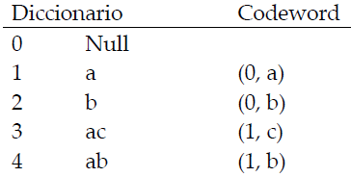
LZ78 (Example)
Compress the following text: “abacabacaba”

Slide 75
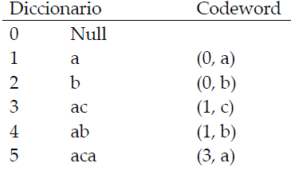
LZ78 (Example)
Compress the following text: “abacabacaba”

Slide 76
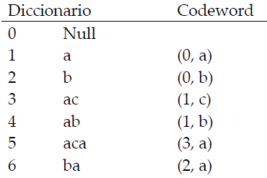
LZ78 (Example)
Compress the following text: “abacabacaba”

Slide 77
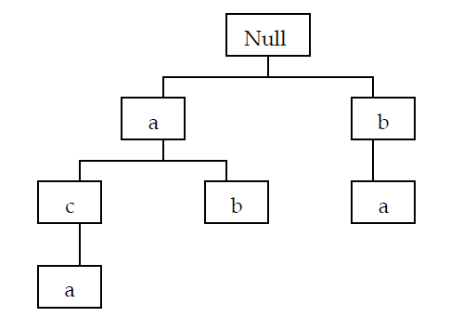
LZ78 (Example)
Compress the following text: “abacabacaba”

Slide 78
LZ78 (Decompression)
Remember, this was the initial instruction
Compress the following text: “abacabacaba”

Slide 79
LZ78 (Decompression)
Compress the following text: “abacabacaba”
And this was the output

Slide 80
LZ78 (Decompression)
Compress the following text: “abacabacaba”
a

Slide 81
LZ78 (Decompression)
Compress the following text: “abacabacaba”
ab

Slide 82
LZ78 (Decompression)
Compress the following text: “abacabacaba”
abac

Slide 83
LZ78 (Decompression)
Compress the following text: “abacabacaba”
abacab

Slide 84
LZ78 (Decompression)
Compress the following text: “abacabacaba”
abacabaca

Slide 85
LZ78 (Decompression)
Compress the following text: “abacabacaba”
abacabacaba

Slide 86
LZ78 (Example)
Compress the following text: “abracadabrarabarabara”

Slide 87
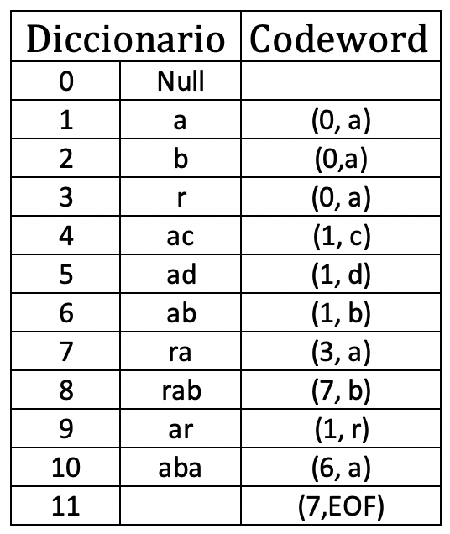
LZ78 (Example)
Compress the following text: “abracadabrarabarabara”

Slide 88
LZW

Slide 89
LZW
Developed by Abraham Lempel and Jacob Ziv and Terry Welch.
It is a variant of LZ78 since it is the one that is most commonly used in practice.
The algorithm maintains a dictionary of strings (sequence of bytes).

Slide 90
LZW
The codeword table is initialized with one entry of each of the 256 possible byte value. These are strings of length one.
As the algorithm progresses it will add new strings to the dictionary such that each string is only added if a prefix one byte shorter is already in the dictionary.
For example, John is only added if Joh had previously appeared in the message sequence.

Slide 91
LZW
Applications: PDF
The dictionary is initialized with one entry of each of the 256 possible byte value. These are strings of length one.
As the algorithm progresses it will add new strings to the dictionary such that each string is only added if a prefix one byte shorter is already in the dictionary.
For example, John is only added if Joh had previously appeared in the message sequence.

Slide 92
LZW (Strategy)
The basic algorithm is very simple and loops executing the following steps:
From i = 0 to 255
Pos(i) <- Si
S = null
While there are symbols at the entrance:
X = next input symbol
If SX exist in the dictionary
S <- SX
X = next input symbol
Write to the output the position of S in the dictionary.
Add SX in the dictionary
S <- X

Slide 93
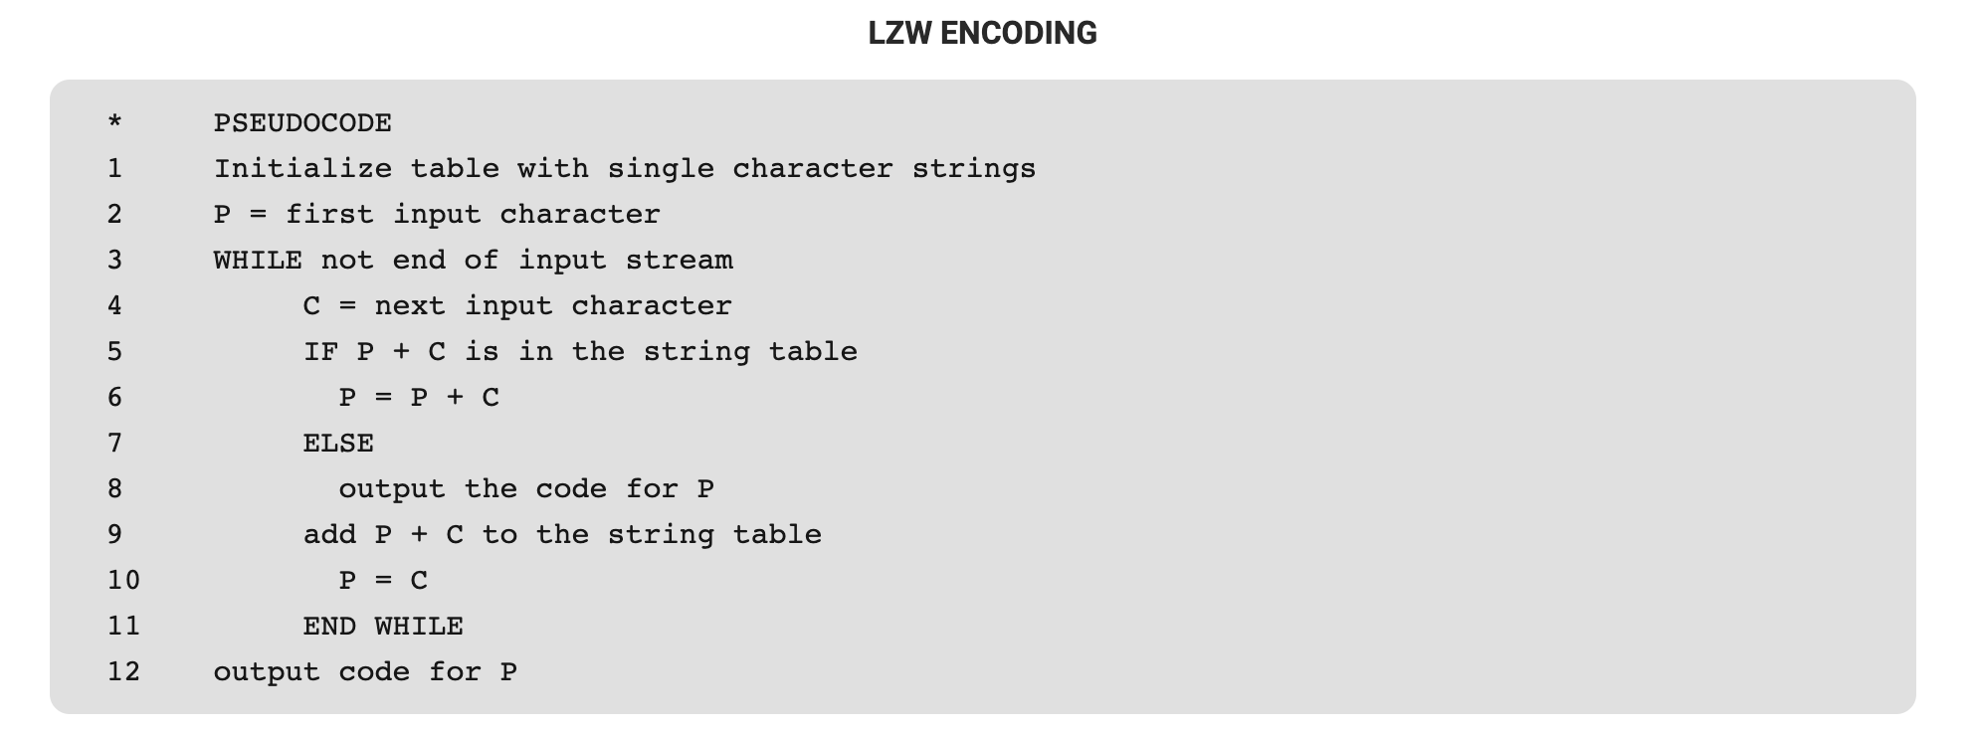
LZW (Strategy)

Slide 94
LZW (Example)
Compress the following text: “abacabaca”

Slide 95
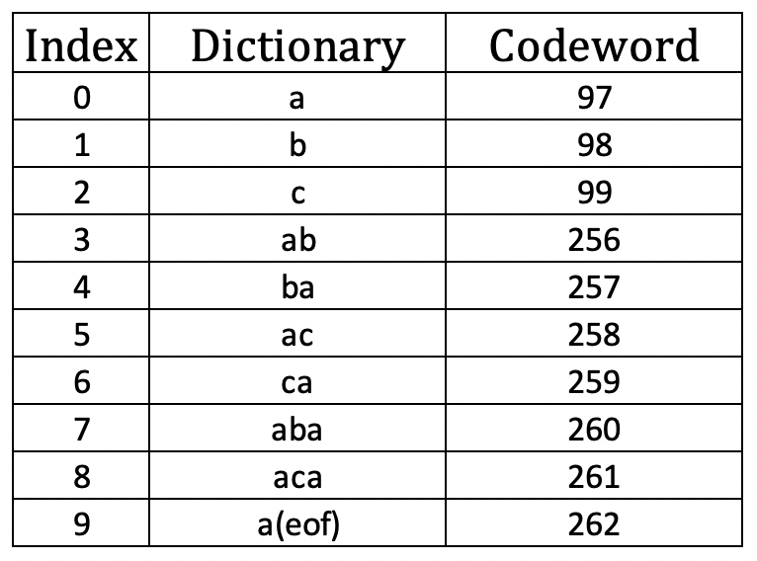
LZW (Example)
Compress the following text: “abacabaca”

Slide 96

LZW (Example)
Compress the following text: “abacabaca”
EXECUTION
P =
C = a
P + C = a
OUTPUT

Slide 97
LZW (Example)
Compress the following text: “abacabaca”
EXECUTION
P = a
C =
P + C = a
OUTPUT

Slide 98

LZW (Example)
Compress the following text: “abacabaca”
EXECUTION
P = a
C = b
P + C = ab
OUTPUT
0

Slide 99
LZW (Example)
Compress the following text: “abacabaca”
EXECUTION
P = a
C = b
P + C = ab
OUTPUT
0

Slide 100
LZW (Example)
Compress the following text: “abacabaca”
EXECUTION
P = b
C = a
P + C = ba
OUTPUT
0 1

Slide 101
LZW (Example)
Compress the following text: “abacabaca”
EXECUTION
P = a
C = c
P + C = ac
OUTPUT
0 1 0

Slide 102
LZW (Example)
Compress the following text: “abacabaca”
EXECUTION
P = c
C = a
P + C = ca
OUTPUT
0 1 0 2

Slide 103
LZW (Example)
Compress the following text: “abacabaca”
EXECUTION
P = a
C = b
P + C = ab
OUTPUT
0 1 0 2

Slide 104
LZW (Example)
Compress the following text: “abacabaca”
EXECUTION
P = ab
C = a
P + C = aba
OUTPUT
0 1 0 2 3

Slide 105
LZW (Example)
Compress the following text: “abacabaca”
EXECUTION
P = a
C = c
P + C = ac
OUTPUT
0 1 0 2 3

Slide 106
LZW (Example)
Compress the following text: “abacabaca”
EXECUTION
P = ac
C = a
P + C = aca
OUTPUT
0 1 0 2 3 5

Slide 107
LZW (Example)
Compress the following text: “abacabaca”
EXECUTION
P = ac
C = a
P + C = aca
OUTPUT
0 1 0 2 3 5 0

Slide 108
LZW (Example)
Compress the following text: “abacabaca”
EXECUTION
P = ac
C = a
P + C = aca
OUTPUT
97 98 97 99 256 258 97

Slide 109
LZW (Decompression)
Compress the following text: “abacabaca”

Slide 110
LZW (Decompression)
Remember, this was the initial instruction
Compress the following text: “abacabaca”
OUTPUT
0 1 0 2 3 5 0

Slide 111
LZW (Decompression)
Compress the following text: “abacabaca”
OUTPUT
0 1 0 2 3 5 0
This is the Dictionary generated with the algorithm

Slide 112
LZW (Decompression)
Compress the following text: “abacabaca”
OUTPUT
0 1 0 2 3 5 0
Output generated with the execution of the algorithm.

Slide 113
LZW (Decompression)
Compress the following text: “abacabaca”
OUTPUT
0 1 0 2 3 5 0
a

Slide 114
LZW (Decompression)
Compress the following text: “abacabaca”
OUTPUT
0 1 0 2 3 5 0
a

Slide 115
LZW (Decompression)
Compress the following text: “abacabaca”
OUTPUT
0 1 0 2 3 5 0
ab

Slide 116
LZW (Decompression)
Compress the following text: “abacabaca”
OUTPUT
0 1 0 2 3 5 0
aba

Slide 117
LZW (Decompression)
Compress the following text: “abacabaca”
OUTPUT
0 1 0 2 3 5 0
abac

Slide 118
LZW (Decompression)
Compress the following text: “abacabaca”
OUTPUT
0 1 0 2 3 5 0
abacab

Slide 119
LZW (Decompression)
Compress the following text: “abacabaca”
OUTPUT
0 1 0 2 3 5 0
abacabac

Slide 120
LZW (Decompression)
Compress the following text: “abacabaca”
OUTPUT
0 1 0 2 3 5 0
abacabaca

Slide 121
LZW (Example)
Compress the following text: “waccawacca”

Slide 122
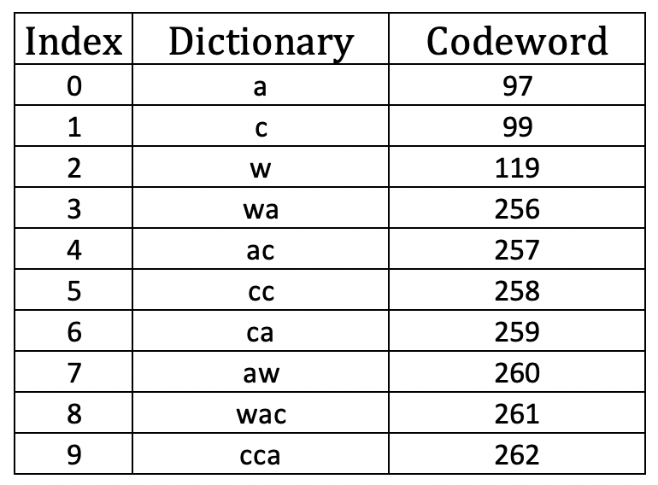
LZW (Example)
Compress the following text: “waccawacca”
OUTPUT
2 0 1 1 0 3 5 0

Slide 123
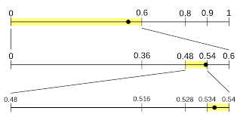
Arithmetic Encoding

Slide 124
Arithmetic Encoding
This is a common algorithm used in both lossless and lossy data compression algorithms.
The frequently seen symbols are encoded with fewer bits than rarely seen symbols. It has some advantages over well-know techniques like Huffman Code.

Slide 125
Arithmetic Encoding (Strategy)
It converts the entire input data into a single floating point number n where (0.0 <= n < 1.0).
The interval is divided into sub-intervals in the ratio of the probability of occurrence frequencies.
For a startpoint and endpoint of an entire range the lower-limit of a character range is the upper-limit of the previous character.
Therefore, each interval corresponds to one symbol.
The reduced interval is partitioned recursively as more symbols are processed.

Slide 126
Arithmetic Coding (Example)
Considering the string “ARBER”:
Symbol | A | B | E | R
Frequency | 1 | 1 | 1 | 2
Probability | 20% | 20% | 20% | 40%

Slide 127
Arithmetic Coding (Example)
Considering the string “ARBER”:
Symbol | A | B | E | R
Frequency | 1 | 1 | 1 | 2
Probability | 20% | 20% | 20% | 40%
The initial ranges would respectively be:
Symbol | A | B | E | R
Ranges | [0, 0.2] | [0.2, 0.4] | [0.4, 0.6] | [0.6, 1]

Slide 128
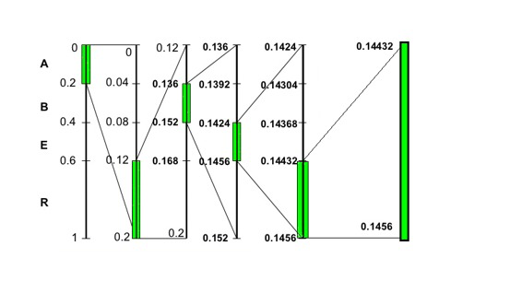
Arithmetic Coding (Example)
“ARBER”
The initial ranges would respectively be:
Symbol | A | B | E | R
Ranges | [0, 0.2] | [0.2, 0.4] | [0.4, 0.6] | [0.6, 1]
The following image shows the construction of the Arithmetic Code:
This is the final interval for “ARBER”

Slide 129
Arithmetic Coding (Example)
“ARBER”
The following image shows the construction of the Arithmetic Code:
Is the same process to decode

Slide 130
Arithmetic Coding (Example)
“ARBER”
The following image shows the construction of the Arithmetic Code:
Decode the number 0.331

Slide 131
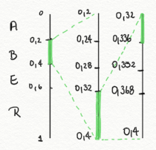
Arithmetic Coding (Example)
“ARBER”
The following image shows the construction of the Arithmetic Code:
Decode the number 0.331 R/ “BRA”

Slide 132
Arithmetic Coding (Example)
Considering the following information:
Symbol | A | B | C
Probability | 20% | 50% | 30%
Encode the input “BAC”

Slide 133
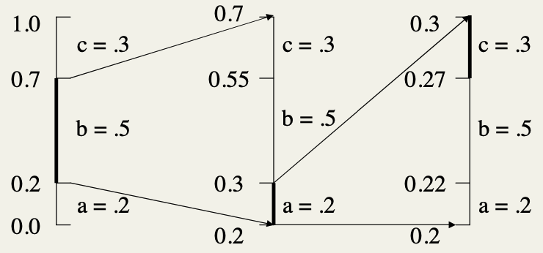
Arithmetic Coding (Example)
Considering the following information:
Symbol | A | B | C
Probability | 20% | 50% | 30%
Encode the input “BAC”

Slide 134
Arithmetic Coding (Example)
Considering the following information:
Symbol | A | B | C
Probability | 20% | 50% | 30%
Try to decode the value 0.718
Encode the input “BAC”

Slide 135
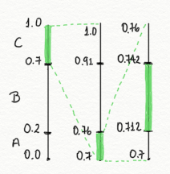
Arithmetic Coding (Example)
Considering the following information:
Symbol | A | B | C
Probability | 20% | 50% | 30%
Try to decode the value 0.718
“CAB”
Encode the input “BAC”

Slide 136
Arithmetic Coding (Comparison)
ADVANTAGES
DISADVANTAGES
Flexibility. It can be used in conjunction with any model that provide a sequence of event probabilities.
Optimality. Is optimal in theory and very nearly optimal in practice, in the sense of encoding using minimal average code length.
Slow. The full precision form of Arithmetic Coding requires at least one multiplication per event and in some implementations up to two multiplications and two divisions per event.

Slide 137
Compression Algorithms
CE2103 - Algorithms and Data Structures II

